Slide 1
SECURE data Hiding in Image using steganography
CAPSTONE PROJECT
Presented By:
Student Name : Shirshika Ghosh
College Name & Department : RCC Institute Of Information Technology (Computer Science and Engineering)

Slide 2
OUTLINE
Problem Statement
Technology used
Wow factor
End users
Result
Conclusion
Git-hub Link
Future scope

Slide 3
Problem Statement
Secure Image-Based Steganography with Passcode Protection: Develop a Secure Image-Based Steganography System where a secret message is hidden inside an image using a user-defined passcode. The system will generate an encrypted image that appears unchanged to a casual observer but contains a hidden message retrievable only with the correct passcode upon Decryption.

Slide 4
Technology used
Libraries Used:
Platforms used:
The coding language used for developing the project is Python. Amidst its wide range of libraries, the following are used:
cv2 (OpenCV) – This is used for reading, modifying, and saving images.
os – Provides functions to interact with the operating system (opening files).
string – Contains string-related utilities, such as predefined character sets.
random – Generates random values, useful for salting and security.
VS Code (Visual Studio Code) – Editor used for writing, debugging, and running the code efficiently.
The code is run on Windows but is platform independent and is able to run on other software like iOS and Linux
GitHub – It is used to upload the code

Slide 5
Wow factors
As we know, Steganography is the practice of concealing a secret message, file, or data within another seemingly harmless medium, such as an image, audio file, or text, in a way that prevents detection. This project performs the same task, and also produces the new picture with the encrypted message.
The image can be in any extension, the code needs to be modified as per the image name and then it’s good to work and can be used widely for hiding any secret message.
The new image is produced and decrypted only if the user wants to decrypt it.
An extra implementation done is that if the user wants a salted encrypted message, a salted message is also produced and is printed, but the original message is only given as output when the correct passcode for decryption is entered.
The choice for salting and decryption is given to the user and if the user doesn’t want to decrypt or salt the message it won’t take place.

Slide 6
End users
The use of Steganography:
Cybersecurity Professionals use steganography to securely transmit sensitive data without attracting attention. What might seem normal to random users might be an encrypted image.
Steganography can be used by the government & military to ensure covert communication and protect classified data from adversaries.
Multinational corporations (MNCs) also use steganography for secure data transmission, protecting trade secrets and confidential information from cyber threats. It helps in intellectual property protection by embedding digital watermarks to prevent counterfeiting and unauthorized use.
Banksalso use steganography to secure financial transactions by embedding sensitive data within digital files, preventing unauthorized access.

Slide 7
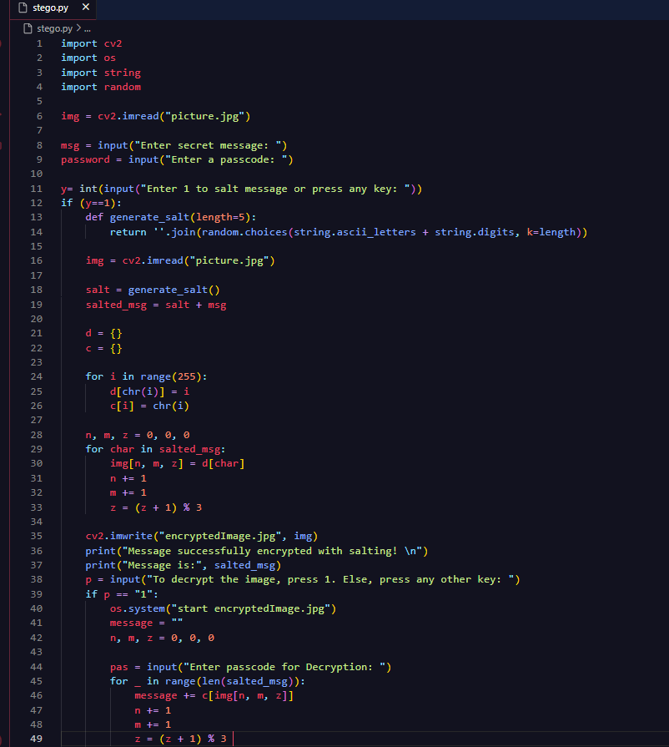
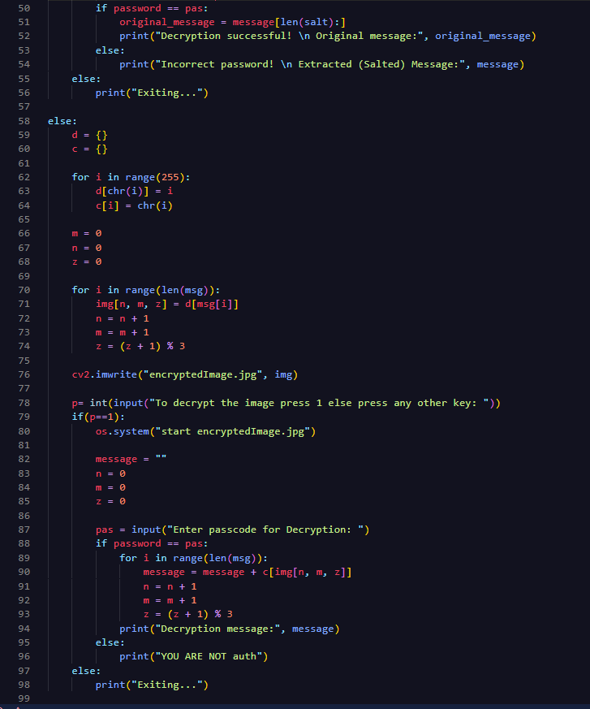
Results (CODE):

Slide 8
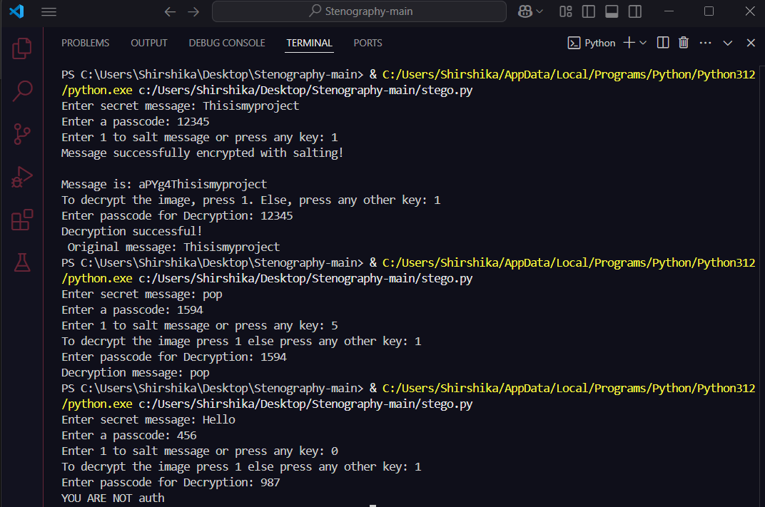
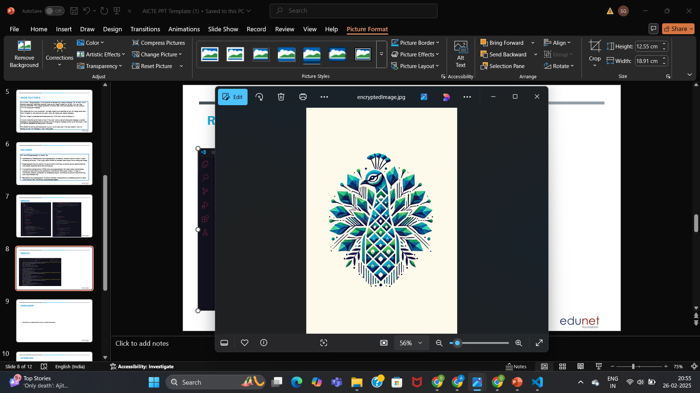
Results
OUTPUT TERMINAL:
Encrypted image:

Slide 9
Conclusion
The Secure Image-Based Steganography System provides an innovative approach to confidential communication by embedding secret messages within images while ensuring access control through a user-defined passcode.
This method enhances data security by making the hidden information undetectable to unauthorized users, preventing cyber threats and information leaks.
By implementing encryption, salting, and secure decryption mechanisms, the system ensures that only the intended recipient can retrieve the message.
This project demonstrates the potential of steganography in real-world applications, including cybersecurity, banking, MNCs and military sectors.

Slide 10
GitHub Link
https://github.com/shirshikaghosh39/project_stegno.git
This is the github link to the project. It includes a readme file describing the project, the main code in python language and a cover image.

Slide 11
Future scope
To develop this project in more advanced way so that it can be implemented efficiently in a better way, these few features can be added:
Developing a website which takes in images that the user provides and encrypts messages and produces an encrypted image.
Implementing more types of files that can be encrypted, such as audio files, text files, video files.
Implementing a live video or camera which takes a photo or a video from the webcam and uses it for encryption.
Implementing a QR code which even after encryption is scannable.

Slide 12
THANK YOU

